Slide 1
CS 2212B
Introduction to Software Engineering
Kostas Kontogiannis
Lecture 4: Requirements Engineering (Chapter 4)

Slide 2
What we will cover
Requirements Specification Techniques
Classic Technique
Object Oriented Technique ←
Use Case Diagrams
Sequence Diagrams
Collaboration Diagrams

Slide 3
Modeling with UML
Requirements Modeling | Scenarios, Use Case Diagrams
Static Modeling | Class Diagrams Object Diagrams Component Diagrams Deployment Diagrams
Dynamic Modeling | Sequence Diagrams Collaboration Diagrams – Communication Diagrams στη UML 2.0
Modeling the behavior of specific objects/classes | State Diagrams
Modeling the execution of system process steps | Activity Diagrams
Modeling system
operation – user’s
view
System
Structure
Modeling
System
Behavior Modeling

Slide 4
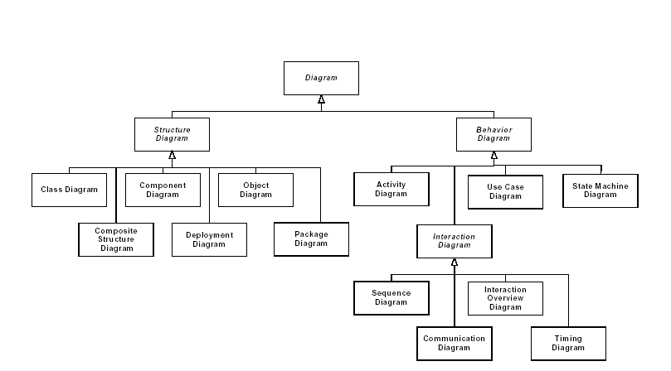
UML 2.0 Diagrams Structure

Slide 5
Interaction
Interaction: Defines and denotes the communication between classifiers e.g. classes (or between objects)
This communication can be achieved with the use of “messages’ (i.e. method invocations) between classifiers or references that pass data (e.g. one class contains a reference to another through an attribute value for example)
“Messages” could take the form of method invocations or processes that affect a class or an object
Messages are partially ordered with respect to time

Slide 6
UML Interaction Diagrams
UML Interaction Diagrams include:
Sequence Diagrams
Collaboration Diagrams
In UML 2.0 the Collaboration Diagrams are referred to as Communication Diagrams

Slide 7
Structural Elements of Interaction Diagrams (1)
Construct
Description
Syntax
Implementaion - Case (object, data, component, process etc.)
Denotes an object as a unique entity. This object can receive and send messages, and can have a state at a given point of time
name
attr values
Action
Speifies en executable command. Some commands are predefined in UML e.g. Create, Call, Destroy, and Uninterpreted.
Text

Slide 8
Structural Elements of Interaction Diagrams (2)
Construct
Description
Syntax
Message
Denote the communication betwen two implementations
Operation
Defines a service which can be requested from an entity (implementation) and relates to the scenario being specified
Κείμενο
(textual)
Message
Specification
Specifies the details of an asynchonous message between two implementations
«Signal» Name
parameters

Slide 9
Structural Elements of Interaction Diagrams (3)
Construct
Description
Syntax
Link
Denotes a link or association between two entities (i.e. implementations)
Variable
Denotes the name of a variable that can take a values as an attribute of an entity (i.e. implementation).
Text

Slide 10
Examples of Interaction Diagrams
x
y
z
1.1: a 1.2: c
a
x
y
b
1.1.1: b
c
z
Sequence Diagram
Collaboration Diagram

Slide 11
Structure of a Sequence Diagram
object symbol
name : Class
other
lifeline
message (stimulus)
name.op (…)
activation
new (…)
: Class
Delete
(termination)
return
κατασκευή
(create)

Slide 12
Message Types
Denotes Synchronous Communication (SendRequest-block-GetResponse-Continue)
Denotes the return of a call (message)
Denotes Asynchronous Communication (SendRequest-DoOtherWorkInBetwen-GetResponse-Continue)

Slide 13
Examples
Nested Flow
Nested Flow
Asynchronous Flow
teller
: Order
: Article
teller
: Order
: Article
caller
exchange
callee
lift receiver
getValue
getValue
dial tone
price
price
dial digit
dial digit
getName
getName
ringing tone
ringing signal
lift receiver

Slide 14
Messages with Conditions and Iteration
calculator
filter
value
[ x > 0]: getValue ()
[ x < 0]: transform ()
getValue ()
iterate ()

Slide 15
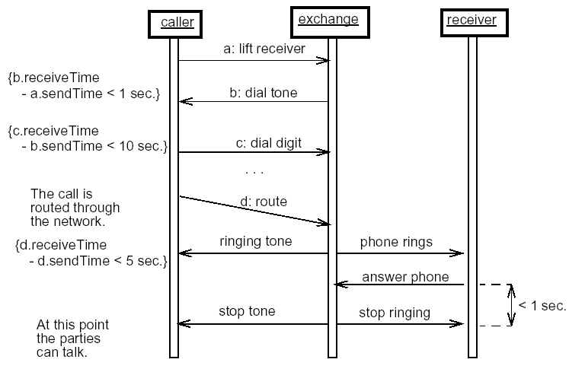
Sequence Diagram with Multiple Active Objects

Slide 16
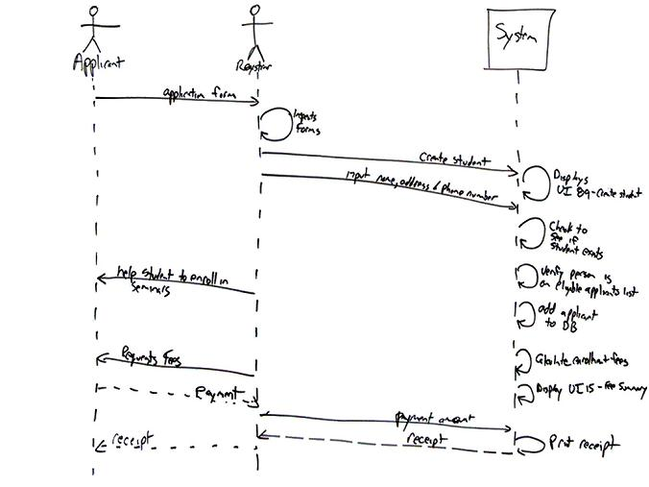
System Level
http://www.agilemodeling.com/artifacts/sequenceDiagram.htm

Slide 17
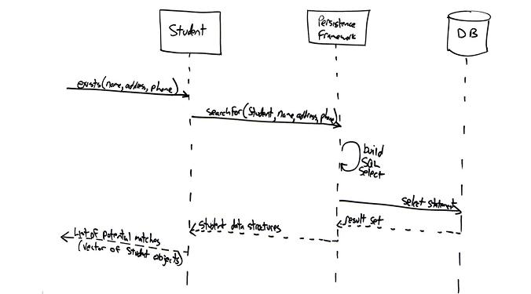
Service Level
http://www.agilemodeling.com/artifacts/sequenceDiagram.htm

Slide 18
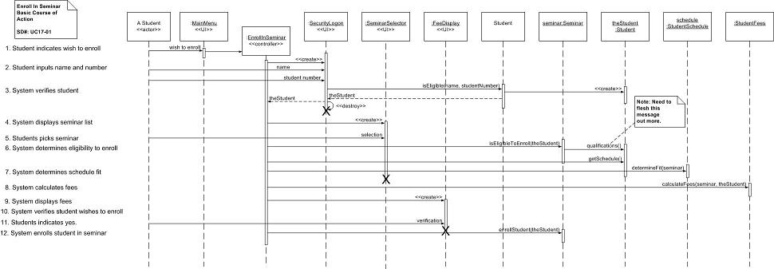
Example of Sequence Diagram
http://www.agilemodeling.com/artifacts/sequenceDiagram.htm

Slide 19
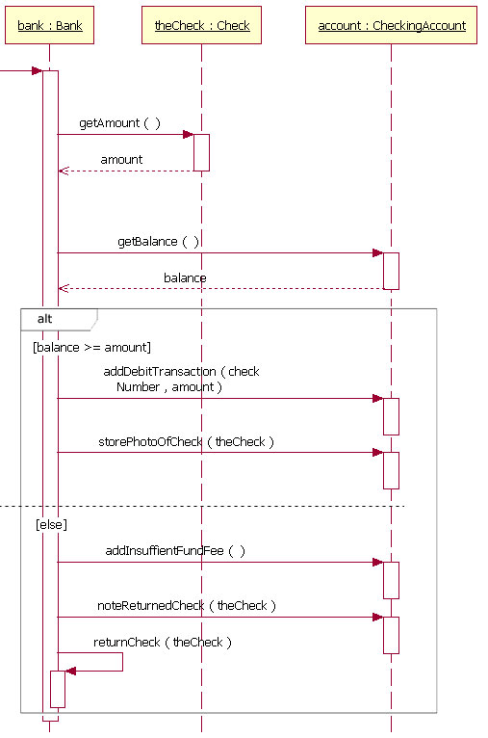
Example with Alternative Flow
http://www-128.ibm.com/developerworks/rational/library/3101.html

Slide 20
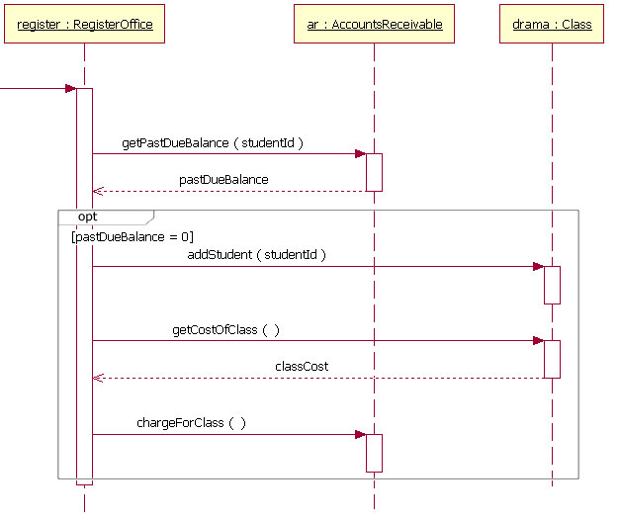
Example with Optional Flow
http://www-128.ibm.com/developerworks/rational/library/3101.html

Slide 21
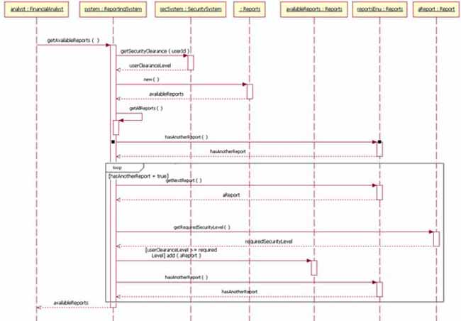
Example with Iterative Flow
http://www-128.ibm.com/developerworks/rational/library/3101.html

Slide 22
Comments on Interaction Diagrams
First we define the context and scope of the interaction based on the scenario being modelled. We include only the objects that are relevant to the specific scenario being modelled. The flow of events is from left to right, top to bottom
We place the most active objects (i.e. objects sending many messages and to many other objects) top left and the most passive objects (i.e. objects that only receive messages) bottom right.
An object is classified as active if it changes the state of other objects, creates new objects, or destroys other objects. An object is classified as passive if it only offers a service
We use sequence diagrams
To model how messages associate over time
To model real time systems
We use communication (collaboration) diagrams
To show the structure and the relations between the entities
To focus on the impact different messages have on the entities (i.e. objects, implementations)

Slide 23
Communication (Collaboration) Diagrams
The Communication (Collaboration) Diagrams aim to model:
The Collaboration between entities (objects, implementations). The collaboration defines the roles these objects play when they are considered in the context of the scenario being modelled
The Interaction between the entities. The interaction defines the way and the pattern of the communication (message exchanges) between the entities that play a role in the scenario
We have two types of Communication Diagrams:
Specification level Communication Diagrams
Instance level Communication Diagrams

Slide 24
Role-based Interaction (Specification Level)
Defines
a role
Sequence Diagram
Collaboration Diagram
/ X
/ Y
/ Z
1.1: a 1.2: c
a
/ X
/ Y
b
1.1.1: b
c
/ Z

Slide 25
Interaction (Instance Level)
Defines
an
instance
Sequence Diagram
Collaboration Diagram
x
y
z
1.1: a 1.2: c
a
x
y
b
1.1.1: b
c
z

Slide 26
Collaboration Diagram with Roles Specification level
/ Teacher : Person
1 tutor
student *
/ Student : Person
position : Text
program : Text
faculty member *
1 lecturer
* participant
faculty 1
given course *
* taken course
: Faculty
: Course

Slide 27
Relation between classifier, instance, and classifier role
Classifier
ClassifierRole
Attribute-1
Attribute-2
Attribute-3
Attribute-1
Attribute-2
Operation-1 (…)
Operation-3 (…)
Operation-1 (…)
Operation-2 (…) Operation-3 (…)
Instance
«συμμορφώνεται με »
«conforms to»
«προέρχεται από»
«originates from»
AttributeValue-1
AttributeValue-2
AttributeValue-3

Slide 28
Association and Association Role
Class
Association
Class
Class-1
0..5
Class-2
{general}
«is a viewpoint
of the class»
«view of»
«view of»
/ Role-1
{specific}
3..4
/ Role-2
ClassifierRole
AssociationRole
ClassifierRole

Slide 29
Roles and Classes
Classes define the full specification of an entity. A class role defines the parts of a class required for a specific type of use of this class.
Role Model
Class Model
/ Teacher : Person
1
*
/ Student : Person
Person
0..1
position : Text
program : Text
name : Text position : Text program : Text
*
1
*
*
*
0..1
1
*
1
*
*
*
*
: Faculty
: Course
Faculty
Course

Slide 30
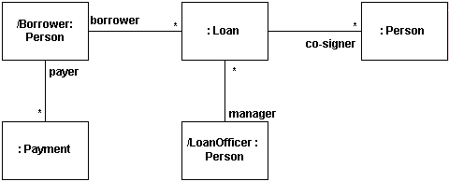
Communication (Collaboration) Diagram at the Specification Level

Slide 31
Communication (Collaboration) Diagram at the Instance Level
object
lnk
standard stereotype)
message
(stimulus)
redisplay ()
window
: Controller
: Window
standard stereotype
window «parameter»
1: displayPositions (window)
constraint
1.1.3.1 add (self)
1.1 *[i := 1..n]: drawSegment (i)
wire
contents {new}
«local» line
{new} : Line
wire :Wire
standard stereotype)
1.1.2: create (r0, r1) 1.1.3: display (window)
«self»
constraint
1.1.1a: r0 := position ()
1.1.1b: r1 := position ()
left : Bead
right : Bead

Slide 32
Message Structure in Communication Diagrams (UML 1.4)
SequenceNumbering [Conditions: [ReturnValue = ] MessageName(parameters)
move (5, 7)
Numbering Format:
1 : actionA
1.1. firstSubactionOfActionA
1.2. secondSubactionOfActionA
1.3. thirdSubactionOfActionA
2 : actionB
2.1. firstSubactionOfActionB
2.1. secondSubactionOfActionB
...
3.7.4: move (5, 7)
3.1: res := getLocation (fig)
Return value
Mesage
Parameters
Numbering
3.7 *[1..5]: move (5, 7)
iteration
3.7 [ z > 0 ]: move (5, 7)
condition

Slide 33
Message Structure in Communication Diagrams (UML 2.0)
The structure of messages in communication diagrams in UML 2.0 is quite similar:
SequenceNumbering : [Conditions] [ReturnValue = ] MessageName(parameters) [: ReturnType]
Example
2.1: [owner >10] res = getName(owner) : string
5.1.2: getCourseName(course) : seminarName
4.2: callHandler(res)

Slide 34
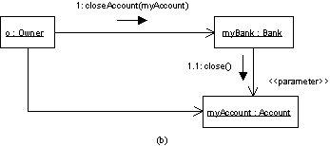
Communication Diagram with Stereotypes
stereotype

Slide 35
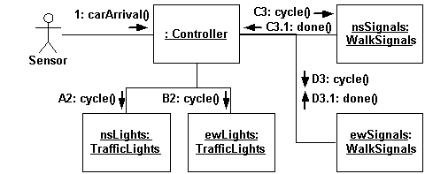
Modeling Concurrent Messages
Messages Α, Β are concurrent
Messages C, D are also concurrent
http://www.agilemodeling.com/style/collaborationDiagram.htm

Slide 36
When Communication Diagrams are Used
We use Communication Diagrams as a tool to identify the entities that play a role in a scenario. It will help us build and refine the Domain Model
To identify the relationship between entities in a given scenario
To associate and map the requirements to the implementation that will follow

Slide 37
Example: Change of Airline Ticket Reservation
Actors: traveler, airline data base, airline reservation system
Preconditions:
The traveler has already logged-in in the system and has selected the “change booking” option
Base use case route:
The system retrieves information related to bookings of the user from its data base
The system prompts the user to select a specific flight; The traveler selects a specific flight
The system prompts the traveler to select a new departure time/date; the traveler provides the required information
If the flight has seats available ...
…
The system confirms the changes provides a summary of the changes.
Alternative use case route:
If the flight does not have seats available then …

Slide 38
Sequence Diagram – Change of Airline Ticket Reservation
Traveler
: Booking System
Client Account DBMS
Client Account DBMS
Airline Reservation System
change flight itinerary
get customer account
get itinerary
present itinerary
select segment
present detailed info
update information
available flight
: :

Slide 39
Communication Diagram – Change of Airline Ticket Reservation
1: change flight itinerary
5: select segment
2: get customer account 3: get itinerary
7: update information
: Booking System
4: present itinerary
Traveler
6: present detailed info
Client Account DBMS
8: available flight
Airline Reservation System

Slide 40
Links to Supporting Material
https://en.wikipedia.org/wiki/Classifier_(UML)
https://www.uml-diagrams.org/
https://stackoverflow.com/questions/15884513/what-is-the-differences-between-class-and-classifier-in-uml
https://en.wikipedia.org/wiki/Sequence_diagram
https://www.ibm.com/developerworks/rational/library/3101.html
https://www.ibm.com/support/knowledgecenter/en/SS6RBX_11.4.2/com.ibm.sa.oomethod.doc/topics/c_UML_collab_diag.html

